Slide 1
Definition ,Principles and Basics of
Management
Principles of Management

Slide 2
Definition

Slide 3


Management Defined
1
Management is the process of achieving goals and objectives effectively and efficiently through and with the people.
2
"Management is a process of designing and maintaining an environment in which individuals work together in groups to effectively and efficiently accomplish selected aims".

Slide 4

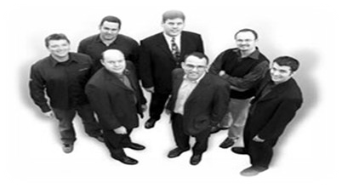
Management Defined Cont’d
₃ Management is the process of achieving organizational goals and objectives effectively and efficiently by using management functions i.e.
Planning
Organizing
Staffing
Controlling
Management is a set of activities directed at an organization's resources with the aim of achieving organizational goals in an efficient and effective manner.
4

Slide 5
These definitions when expanded have these implications:
Management is thus a continuous effort aimed at shaping an organization and contributing to its overall growth.
The functions of managers include planning, organizing, staffing, leading and controlling.
These functions are essential to any kind of organization.
It applies to managers at all hierarchical levels.
The aim of managers is to increase productivity, effectiveness and efficiency.

Slide 6
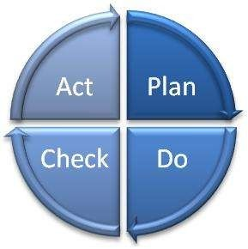


Elements of definition
•
Process - represents ongoing functions or primary activities engaged in by managers
Efficiency - getting the most output from the least amount of inputs “doing things right”
concerned with means Achieving the objectives in time
•
•
•
Effectiveness - completing activities so that organizational goals are attained “doing the right things”
concerned with ends
Achieving the objectives on time
•
•
•

Slide 7
Efficiency and Effectiveness
Means Efficiency
Ends Effectiveness
Goals
Resource Usage
Goal Attainment
Low
Waste
High Attainment
FOM 1.9

Slide 8
Management: Science or Art?
Science is a collection of systematic knowledge, collection of truths and inferences after continuous study and experiments. It has fundamental principles discovered.
Art uses the known rules and principles and uses the skill, expertise, wisdom, experience to achieve the desired result.
Management has got two faces like a coin; on one side it is art and on the other it is science. Management has got scientific principles which constitute the elements of Science and Skills and talent which are attributes of Art.
Management is both art and science.

Slide 9
Principles of Management

Slide 10
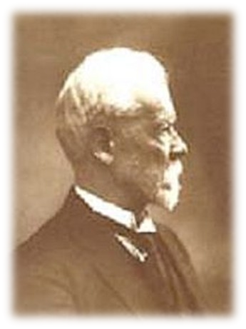
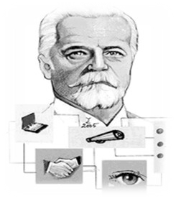
Fayol’s Principles of Management
Henri Fayol (1841-1925)
He has proposed that there are six primary functions of management and 14 principles of management, Forecasting, Planning, Organizing, Commanding, Coordinating, controlling
There are 14 Principles of Management described by Henri Fayol.

Slide 11

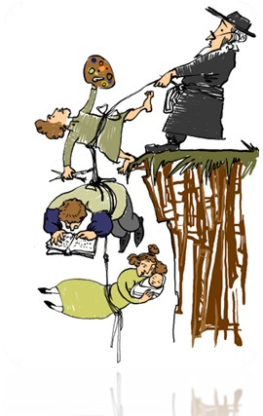
14 Principles of Henri Fayol
1. Division of Labor
Work of all kinds must be divided & subdivided and allotted to various persons according
to their expertise in a particular area.
2. Authority & Responsibility
Authority refers to the right of superiors to get exactness from their sub-ordinates. Responsibility means obligation for the performance of the job assigned.
Note that responsibility arises wherever authority is exercised

Slide 12
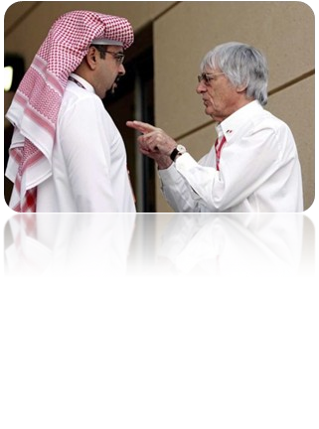

14 Principles of Henri Fayol Cont’d
3. Unity of Command
A sub-ordinate should receive orders and be accountable to one and only one boss at a time. He should not receive instructions from more than one person
4. Unity of Direction
People engaged in the same kind of business or same kind of activities must have the same objectives in a single plan.
Without unity of direction, unity of action cannot be achieved.

Slide 13


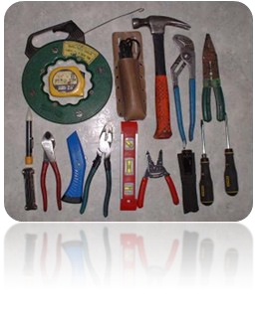
14 Principles of Henri Fayol Cont’d
5. Equity
Equity means combination of fairness, kindness & justice.
The employees should be treated with kindness & equity if devotion is expected of them.
6. Order
This principle is concerned with proper & systematic arrangement of things and people.
Arrangement of things is called material order and placement of people is called social order.

Slide 14


14 Principles of Henri Fayol Cont’d
7. Discipline
Discipline means sincerity, obedience, respect of authority & observance of rules and
regulations of the enterprise.
Subordinate should respect their superiors and obey their order.
8. Initiative
Initiative means eagerness to initiate actions without being asked to do so. Management should provide opportunity to its employees to suggest ideas,
experiences& new method of work.

Slide 15


14 Principles of Henri Fayol Cont’d
9. Remuneration
Remuneration to be paid to the workers should be fair, reasonable, satisfactory &
rewarding of the efforts.
It should accord satisfaction to both employer and the employees.
10. Stability of Tenure
Employees should not be moved frequently from one job position to another i.e. the period of service in a job should be fixed.

Slide 16
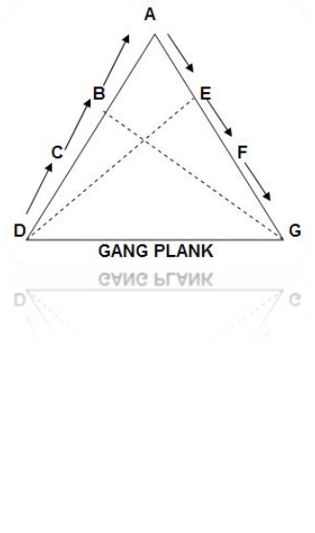

14 Principles of Henri Fayol Cont’d
11. Scalar Chain
Scalar chain is the chain of superiors ranging from the ultimate authority to the
lowest.
Communications should follow this chain. However, if following the chain creates delays, cross-communications can be allowed if agreed to by all parties and superiors are kept informed.
12. Sub-ordination of Individual Interest to common goal
An organization is much bigger than the individual it constitutes therefore interest of the undertaking should prevail in all circumstances.
The interests of any one employee or group of employees should not take precedence over the interests of the organization as a whole.

Slide 17


14 Principles of Henri Fayol Cont’d
13. Espirit De’ Corps
It refers to team spirit i.e. harmony in the work groups and mutual understanding among
the members.
Espirit De’ Corps inspires workers to work harder.
14. Centralization
Centralization refers to the degree to which subordinates are involved in decision making.
Whether decision making is centralized (to management) or decentralized (to subordinates) is a question of proper proportion. The task is to find the optimum degree of centralization for each situation.

Slide 18
Theory X and Y Douglas McGregor
Theory X
Theory Y
•
•
•
•
Average worker is lazy Dislikes work
•
•
Workers are not inherently lazy Do not naturally dislike work
If given the opportunity, will do what is good for the organization.
Will try to do as little as possible•
Have little ambition and avoid responsibility

Slide 19
Basics of Management

Slide 20




Organization
Organizations are groups of people, with ideas and resources, working toward common goals.
OR
A systematic arrangement of people brought together to accomplish some specific purpose is called organization.
Characteristics of Organization
Distinct Purpose
Deliberate Structure
People

Slide 21

Manager
A manager is someone whose primary responsibility is to carry out the management process within an organization to achieve the organizational goals.
Changing nature of organizations and work has blurred the clear lines of distinction between managers and non-managerial employees

Slide 22
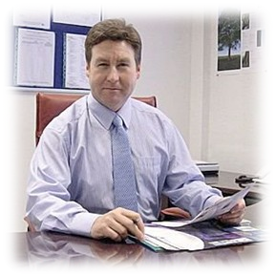
Managerial skills
Managerial Skills
Primary Skills
Secondary Skills
Conceptual Skill
Technical Skill
Human Skill
Design Skill
Communication Skill
Leadership Skill

Slide 23


Managerial skills Cont’d
Conceptual skills:
This refers to the ability to think and conceptualize abstract situations. These abilities are required for making complex decisions.
In short it is:
The mental capacity to develop plans, strategies and vision
Human or interpersonal skills:
This includes the ability to understand other people and interact effectively with them. The human skills are also important in creation of an environment in which people feel secure and free to express their opinions.
In short it is:
The ability to work with other people in teams

Slide 24


Managerial skills Cont’d
Technical skills:
These skills include the knowledge, abilities of and proficiency in activities involving methods, processes and procedures in the relevant fields as accounting, engineering, manufacturing etc.
Or in short:
The ability to use the knowledge or techniques of a particular discipline to attain ends
Design skills:
These skills enable a manager to handle and solve any kind of unforeseen or actual problems, that may crop up in the organization. Such problems could arise due to internal factors or external factors and/or both.
In short it is:
The problem solving skill

Slide 25


Managerial skills Cont’d
Communication skills:
The abilities of exchanging ideas and information effectively. To understand others and let others understand comprehensively.
Leadership skills
The abilities to influence other people to achieve the common goal.

Slide 26
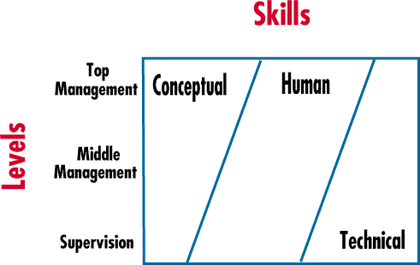
Skill distribution at various management levels

Slide 27

Roles of manager
Role: a set of expectation for one’s behavior
In 1960, Henry Mintzberg conducted a study to understand about the managerial roles. He identified 10 managerial roles that are common to all managers.
These 10 managerial roles are grouped under: Interpersonal, decisional, and
informational roles.
Roles of Manager
Interpersonal
Decisional
Informational
Figurehead
Leader
Liaison
Entrepreneur
Disturbance handler
Resource allocator
Negotiator
Monitor
Disseminator
Spokesperson

Slide 28
Roles of manager Cont’d
A: Inter-personal Role
Figurehead: Represents the company on social occasions. Attending the flag hosting ceremony, receiving visitors or taking visitors for dinner etc.
Leader: In the role of a leader, the manager motivates, encourages, and builds enthusiasm among the employees. Training subordinates to work under pressure, forms part of the responsibilities of a manager.
Liaison: Consists of relating to others outside the group or organization. Serves as a link between people, groups or organization. The negotiation of prices with the suppliers regarding raw materials is an example for the role of liaison.

Slide 29
Roles of manager Cont’d
B: Decisional Role:
Entrepreneur: Act as an initiator and designer and encourage changes and innovation, identify new ideas, delegate idea and responsibility to others.
Disturbance handler: Take corrective action during disputes or crises; resolves conflicts among subordinates; adapt to environmental crisis.
Resource allocator: Decides distribution of resources among various individuals and groups in the organization.
Negotiator: Negotiates with subordinates, groups or organizations- both internal and external. Represents department during negotiation of union contracts, sales, purchases, budgets; represent departmental interests

Slide 30
Roles of manager Cont’d
Informational role:
1. Monitor: Emerges as nerve center of internal and about Information.
external
information
Disseminator: Transmits information received from other employees to members of the organization.
Spokesperson: Transmits information to the people who are external to the organization, i.e., government, media etc. For instance, a manager addresses a press conference announcing a new product launch or other major deal.

Slide 31
Functions of management
1
Planning is the process of setting goals, and charting the best way of action for achieving the goals. This function also includes, considering the various steps to be taken to encourage the necessary levels of change and innovation.
Planning
2
Organizing
Organizing is the process of allocating and arranging work, authority and resources, to the members of the organization so that they can successfully execute the plans.
3
A: Staffing is the process of filling the positions in the organization and keeping them filled.
B: Staffing is the process of recruiting and selecting the right person for the right job at the right time in the right place.
Staffing
4
Leading involves directing, influencing and motivating employees to perform essential tasks. This function involves display of leadership qualities, different leadership styles, different influencing powers, with excellent abilities of communication and motivation.
Leading
5
Controlling
Controlling is the process of devising various checks to ensure that planned performance is actually achieved. It involves ensuring that actual activities conform to the planned activities. Monitoring the financial statements, checking the cash registers to avoid overdraft etc., form part of this process.

Slide 32
Levels of management
1. Top Level:
Top management sets the mission and goals, develops policies, evaluates the overall performance of various departments, responsible for the business as a whole and is concerned mainly with long-term planning
2. Middle Level:
Middle level management develops departmental goals, executes the policies, plans and strategies determined by top management , develops medium- term plans and supervises and coordinate lower-level managers’ activities
2. Lower (Supervisory, frontline) Level:
Lower level management takes charge of day-to-day operations, is involved in preparing detailed short-range plans, is responsible for smaller segments of the business, executes plans of middle management , guides staff in their own subsections and keep close control over their activities

Slide 33

Levels of management
Top Management President, CEO, Executive
Vice Presidents
Middle Management
Plant Managers, Division Managers, Department Managers
First-Line Management
Foreman, Supervisors, Office Managers
Non- Managerial Employees

Slide 34
Importance of management functions to managers in each level
Most Important
Organizing
Staffing Directing
Controlling
Planning
Organizing
Staffing Directing Controlling
Planning
Organizing Staffing Directing Controlling
Planning
Least Important
Top Managers
Middle Managers
First-Line Managers

